Slide 1
Using APIs

Slide 2
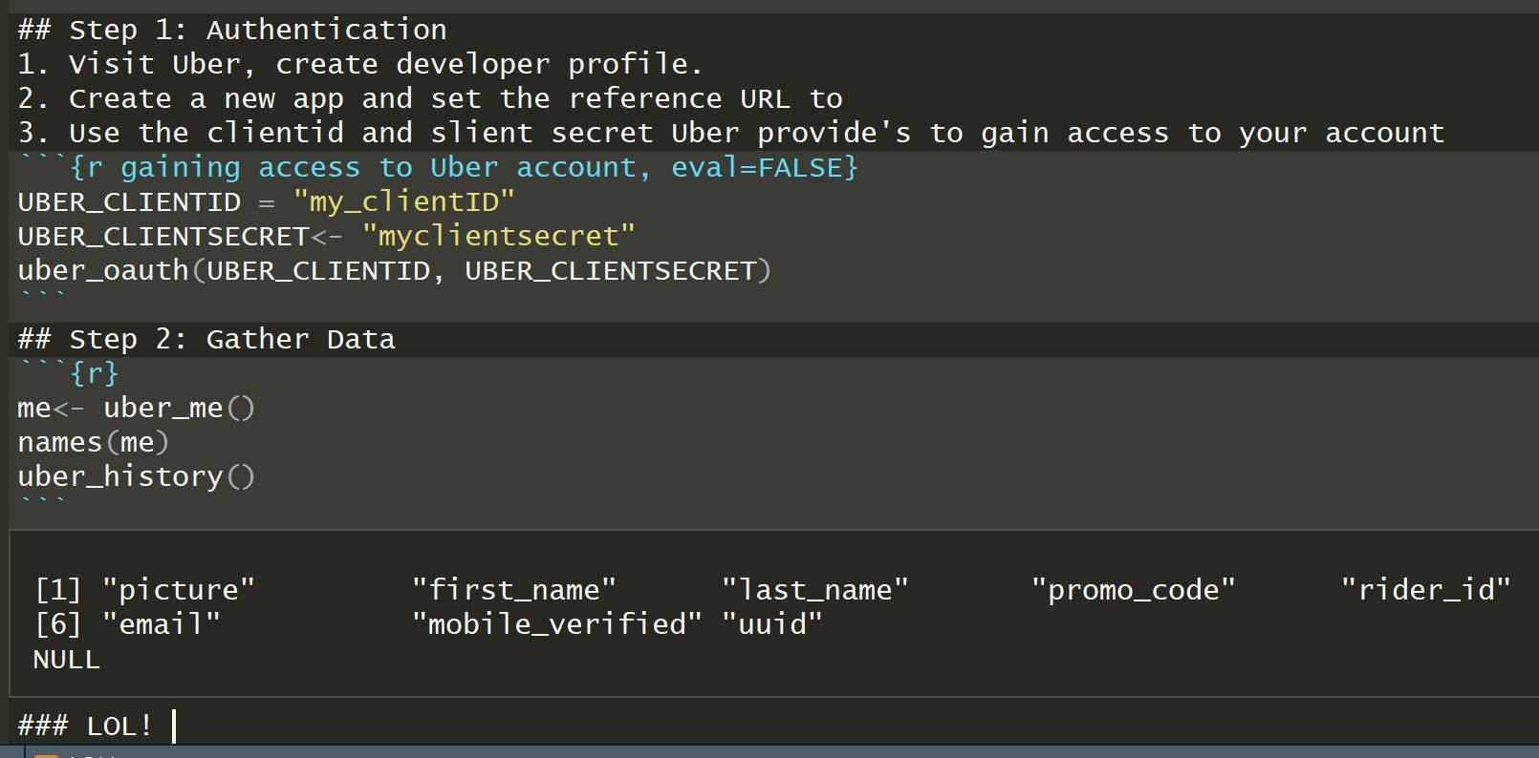
First Attempt: Uber
I drove for Uber last summer, so I wanted to check out my data.
I set up a developer account with them.
Downloaded the ubeR package
I followed the directions Uber gave and after a littler trial and error….
I discovered that my driver account was not attached and Uber requires their permission to grant access to driver data.

Slide 3
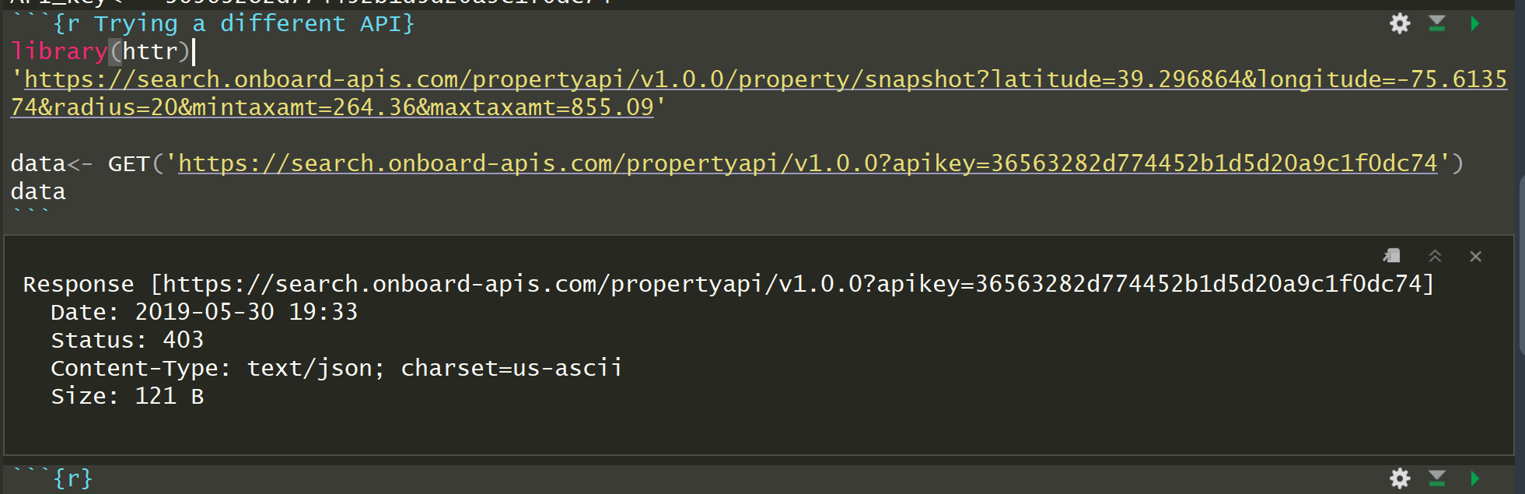
Second Attempt: ATTOM data solutions
I’ve flipped a couple of houses, so I’d like to easily get data on comps. I found an API that offers free trial access to its real estate API.
I signed up for access to the API, gained an API key but…
I could not figure out how to authenticate
The api key goes in the header...after a “?”, but beyond that, I don’t know how to get past authentication.
This was exceedingly frustrating, so I moved on to less interesting data sources.

Slide 4
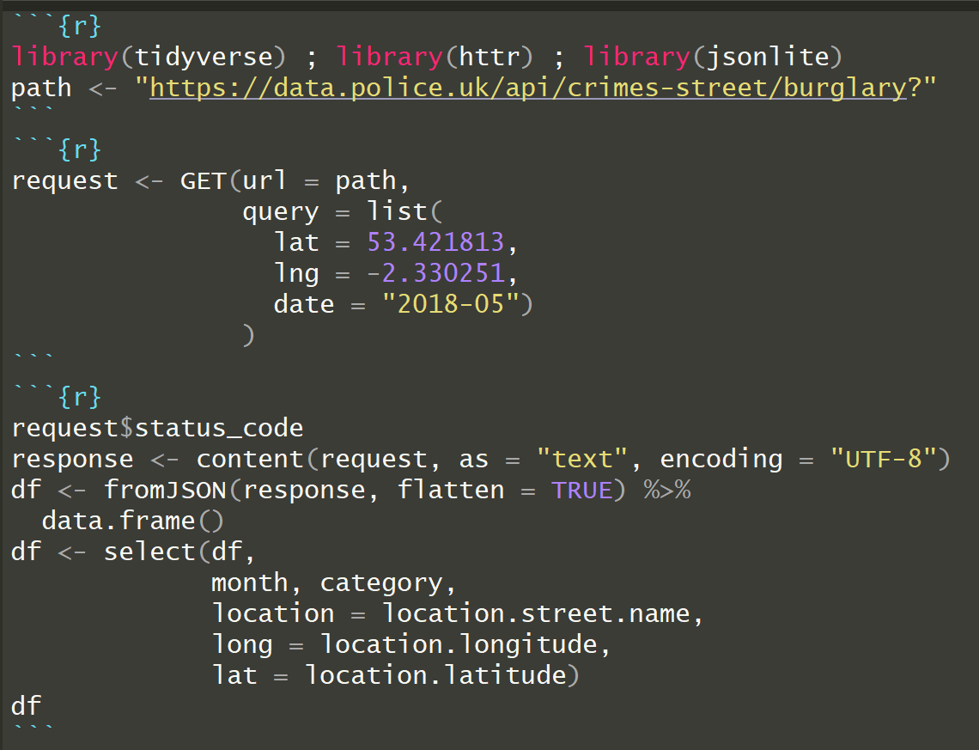
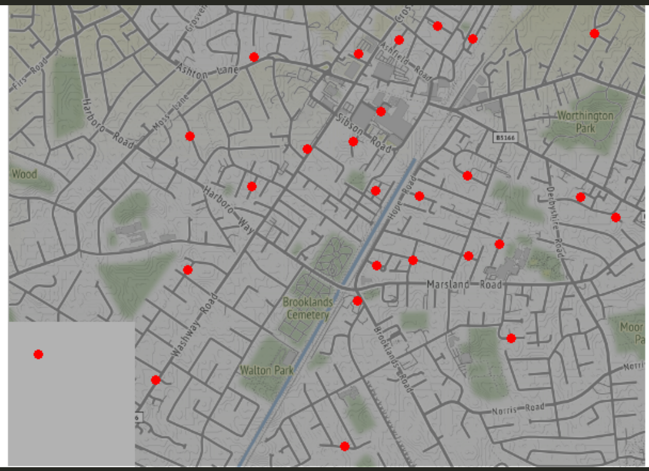
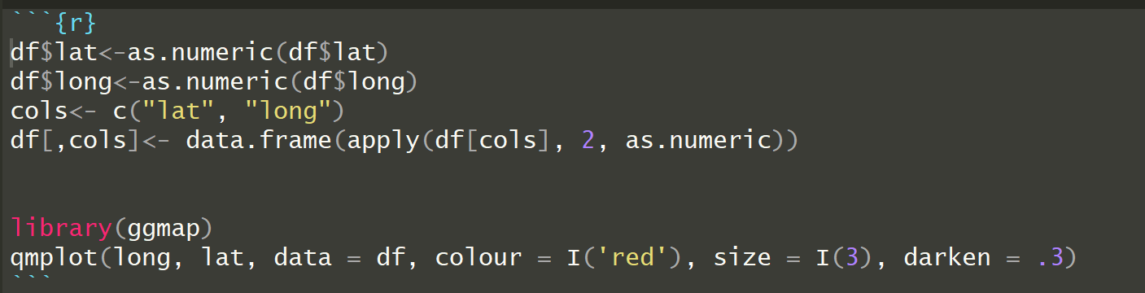
3rd Attempt: Crimes in London
My problem is access, so I found a working example from an API that doesn’t require an API key
I found an example that helped me get information.
I needed to turn the latitude and longitude coordinates into numbers before I could map burglaries
While it was not at all what I set out to do, I did make a simple visualization showing burglaries in London using data from an API

Slide 5
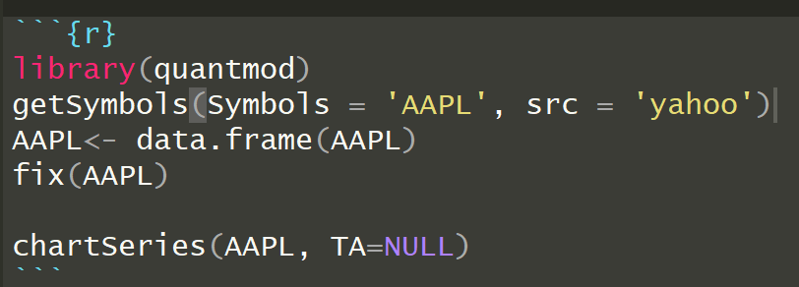
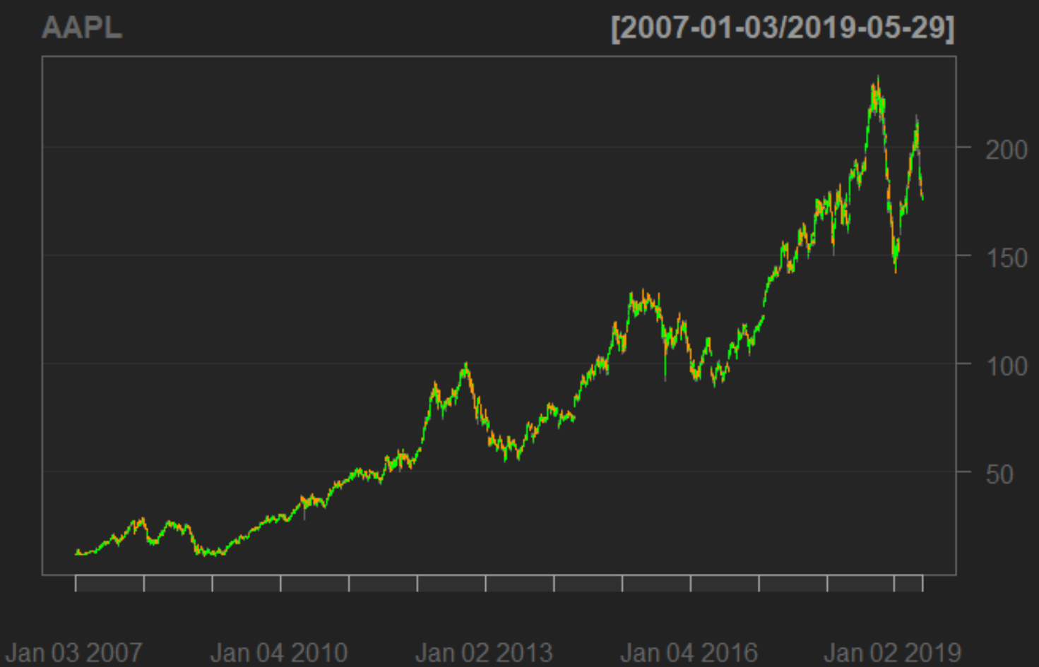
4th attempt: quantmod, yahoo finance
This one was very simple, but the most satisfying
Quantmod is a great package!
very easy to use, plenty of documentation

